Slide 1

Department of Computer Science and Engineering
UNIVERSITY EVENT ANALYTICS PLATFORM
Review-3
Team Number:24
Name: Roll Number:
K Dharani Harika 2420030304
T Lasya Priya 2420030258
V Durga 2420030184
Under the guidance of:
Dr.N. Sirisha
Associate Professor
Koneru Lakshmaiah Education Foundation

Slide 2
OBJECTIVES
Data centralization – Centralize all the event-related information (registration, attendance, feedback) that is collected by various departments.
Attendance automation – Introduce automated attendance by implementing QR codes/RIFD for event check-in to avoid manual counting and reduce errors.
Event monitoring in real time – Use Apache Kafka for event stream processing and Redis for in-memory counters to ensure real-time dashboards reflecting actual attendance numbers during the event.
Creation of reliable data pipeline – Create a robust data extraction, cleaning and loading pipeline to feed data into a structured data warehouse for consistent analytics.
Creation of actionable insights – Create dashboards displaying trends of attendance and engagement for stakeholders (administrators, faculty members, student event organizers).
Application of AI for forecasting – Use historical data for forecasting future attendance and allocating resources accordingly.
Sentiment analysis of feedback – Automatically analyze student feedback to find out their satisfaction level and get insights on strengths and weaknesses of particular events.
Decision-making based on data – Create reports automatically for accreditation institutions and assist in increasing students’ participation.
Relevant recommendations for students based on participation history.

Slide 3
LITERATURE SURVEY
Source | Authors | Demerits | Future Direction
academia.edu | Joshi et al. | Needs dedicated readers at every entry point; struggles with multi-tag collisions in dense crowds; no analytics/dashboard layer. | Integrate multi-antenna anti-collision protocols and connect RFID logs to a live analytics dashboard for large, multi-entry events.
doaj.org | Abu Sneineh & Salah | Static QR codes are easy to screenshot/share, enabling proxy check-ins; not designed for real-time streaming to a live dashboard. | Move to dynamic, time-limited QR tokens and push scans to a streaming pipeline for real-time attendance visualization.
meral.edu.mm | Aung & Maw | Tested on generic big-data workloads rather than campus/event traffic; does not cover visualization or dashboard integration. | Validate the Kafka-Storm architecture on real event-attendance traffic and extend it with a front-end visualization layer.
orbilu.uni.lu | Falk et al. | Built and evaluated for telecom network data; requires modifying Kafka internals, raising deployment complexity for small teams. | Package the native filtering/transformation logic as a reusable Kafka plugin so smaller teams can adopt it without core changes.
math.spbu.ru | Dayal et al. | Conceptual/architectural only, no working prototype; predates modern streaming tools such as Kafka and needs adaptation. | Build a working prototype of the proposed data-flow framework using modern ETL/ELT and streaming tools like Kafka and Spark.

Slide 4
Source | Authors | Demerits | Future Direction
jtsiskom.undip.ac.id | Zulfa et al. | Evaluated on an academic GPA dataset, not live event-attendance streams; no discussion of cache invalidation or clustering. | Test Redis caching on live, high-frequency attendance streams and add cache-invalidation and clustering strategies for scale.
ir.iba.edu.pk | Nasim et al. | Limited to coarse positive/negative polarity; lexicon resources need manual, domain-specific curation, not built for streaming. | Extend to fine-grained, multi-class sentiment and automate lexicon updates so the model can process streaming feedback.
christuniversity.in | Kumar et al. | Transformer models like BERT are computationally heavy for low-latency dashboards; multi-modal extension raises privacy concerns. | Explore lighter, distilled transformer variants for near-real-time inference and add privacy-preserving multi-modal techniques.
unpaywall.org | Herzog & Wörndl | Cold-start problem persists for brand-new events with no prior ratings; evaluated over only a two-week mobile-app field study. | Address cold-start using content/context features for new events and run longer-term, larger-scale field studies to confirm results.
politesi.polimi.it | Awad | Single-institution thesis-level evaluation with limited generalisability; no integration with a real-time streaming pipeline. | Validate the prediction/recommendation models across multiple institutions and integrate into a live streaming attendance pipeline.

Slide 5
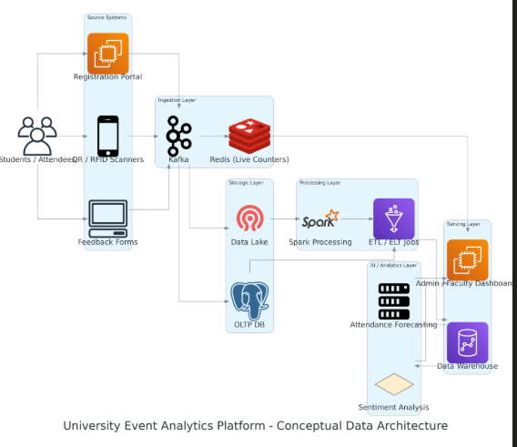
SYSTEM ARCHITECTURE

Slide 6
METHODOLOGY
Data Collection: Collect event, registration, attendance and feedback data.
Data Integration: Combine all event-related data into one platform.
Data Processing: Validate, clean and transform collected data.
Real-Time Processing: Process attendance events using Kafka and Redis.
Data Storage: Store structured information in PostgreSQL and the warehouse.
Analytics: Calculate attendance, participation and event performance metrics.
AI Analysis: Perform attendance forecasting and feedback sentiment analysis.
Feedback Analysis: Analyze participant feedback using sentiment analysis to identify overall response.
Attendance Forecasting: Use available registration and event data to estimate expected attendance.

Slide 7
USE OF MODERN TOOLS AND TECHNOLOGIES
Python: Backend logic and data processing.
PostgreSQL: Structured and persistent data storage.
Apache Kafka: Real-time event streaming.
Redis: Fast live attendance monitoring.
QR Technology: Automated student check-in.
Streamlit: Interactive analytics dashboard.
Machine Learning & Sentiment Analysis: Forecast attendance and analyze feedback.

Slide 8
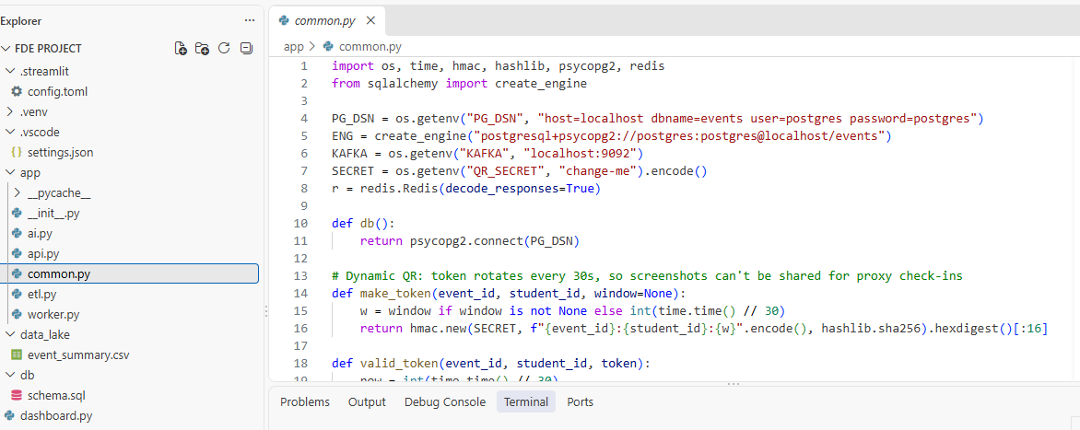
IMPLEMENTATION

Slide 9
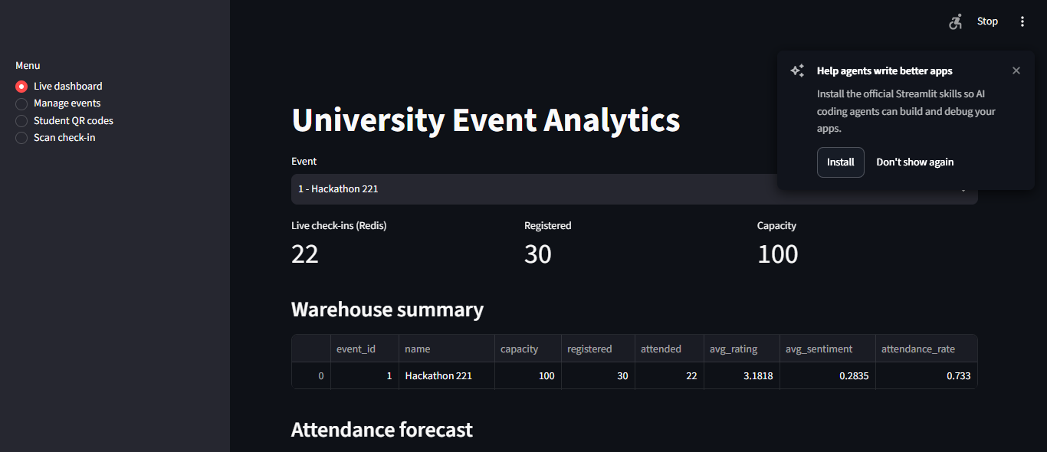

Slide 10
CODING QUALITY AND FUNCTIONALITY
Modular Design: Separate components for registration, attendance and analytics.
Input Validation: Validate event, student and attendance data.
Error Handling: Handle invalid requests and system/database errors.
Data Consistency: Maintain structured and reliable event records.
Reusable Components: Use common functions for repeated operations.
Real-Time Functionality: Support live attendance updates.
Maintainability: Organized code structure allows easier modification and extension.

